Slide 1
Firmware Over the Air
Project Proposal

Slide 2
Team members
Ahmed Adel Qandeel.
Amr Ibrahim Nobe.
Marcelle Samir Isaac.
Marina Medhat Zekry.
Mohanad Fawzy Sallam.
Mostafa Nader Eltourky.

Slide 3
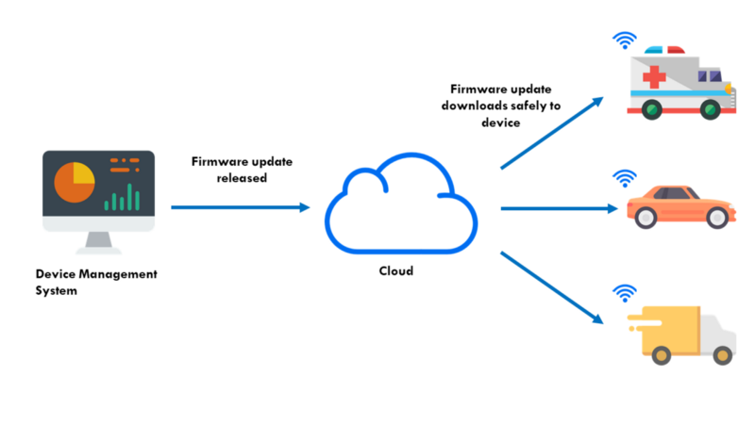
Project Overview
1
2
3

Slide 4
Project sub-systems
PC Application system.
RaspberryPi Server system.
µC system.
(OEM)
(Cloud Server)
(Vehicle)

Slide 5

Project Block Diagram
PC Application
µC
1
2
Server
3
4

Slide 6
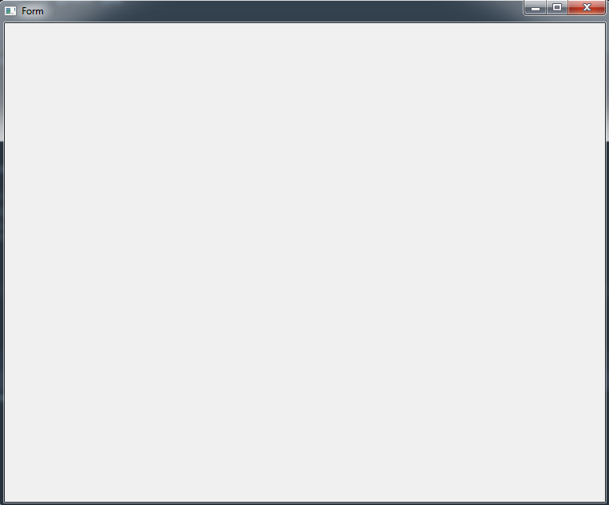
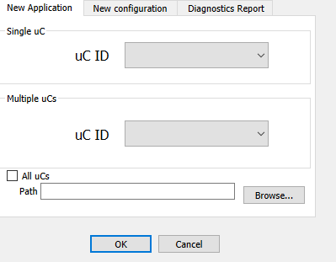
First Sub-System: PC Application
Select µC (s).
Select New Application .elf file
Click Ok to start flashing
Pc Application

Slide 7
First Sub-System: PC Application
After The Application is written to the uC, the Pc will receive a confirmation message (Confirmation Report).
Pc Application

Slide 8
First Sub-System: PC Application
New Configuration and Diagnostics Report are considered as an extra Features.
New configurations will flash the new configurations at specified location in µC Rom (post-build configurations).
Diagnostics Report will return a small report that contains:
Flashing Req’s #.
Marker (status) value.
Booting times #.
Pc Application

Slide 9
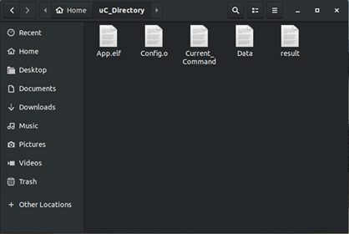
Second sub-system: Raspberry Pi server
Considered as FOTA cloud and serves as a channel between PC Application (OEM) and µC (Vehicle).
For every µC in the system, it will have a folder inside the Rπ that contains five files.

Slide 10
Second sub-system: Raspberry Pi server
Current_command: The PC application will write command code in this file.
The Rπ checks the file and based on the command code it will take suitable action.
PC App -> Rπ.
After executing, the Rπ clears the file.

Slide 11
Second sub-system: Raspberry Pi server
Data: The Rπ and µC communicates via Data file.
Both have the read and write access for communication.
The Rπ and µC follows flashing protocol to avoid overriding data in this file.
µC <--> Rπ.

Slide 12
Second sub-system: Raspberry Pi server
result: The Rπ writes the current process status on this file to generate the status report to the PC App.
The PC will generate the Status report based on the code written in this file .
PC APP <- Rπ.

Slide 13
PC App – Rπ communication
The App sends start signal ( after pressing ok button) by sending the .elf /.o file via internet to the Rπ .
The Application writes command code in the Command_file.
The Rπ (background process) checks the command file and if its not IDLE (new command appears) it will start communication with the µC and send status to the App via result file.
Periodically, The App checks the result file to generate the status message (Report) for the App User.
After finishing with the µC, The Rπ writes finish code to the App.

Slide 14
Rπ - µC communication
After receiving command from the App (via current_command file), the Rπ writes command code to the µC by writing on data file .
The µC will have a periodic task that checks on data file and if it finds out that there is a new command, the task will change the status flag (marker) and reboots the µC .
The Bootloader will checks the marker flag and based on the value, it will take the suitable procedure.
After finishing with the µC, The Rπ writes finish code to the App.

Slide 15
Rπ - µC communication
After receiving command from the App (via current_command file), the Rπ writes command code to the µC by writing on data file .
The µC will have a periodic task that checks on data file and if it finds out that there is a new command, the task will change the status flag (marker) and reboots the µC .
The Bootloader will checks the marker flag and based on the value, it will take the suitable procedure.
After finishing with the µC, The Rπ writes finish code to the App.
There are three types of commands to be given to the µC:
Flash New Sw (Application/ Configuration).
Get diagnostic status from the µC.

Slide 16
Rπ - µC comm: Frames Types
We have eight types of frame.
These frames will be represented (written) in the Data File.
The General structure of the frame consists of Header & Data.
The Header starts with Direction (0: Rπ -> µC, 1: µC -> Rπ).
The header contains frame type.
The header contains Check Byte.
Header = (Direction + frame type + Check).
The data differs from frame type to another.
ID | Type
0 | Start Flashing Frame
1 | Start Section Frame
2 | Data Frame
3 | Ack Frame
4 | Error Frame
5 | End Section Frame
6 | End Flash Frame
7 | Diagnostic Req Frame
8 | Diagnostic Report Frame

Slide 17
Rπ - µC comm: Frames Types
Start Flashing Frame: Contains START_FLASH_KEY and µC_ID.
Start Section Frame: Contains section number, physical address, file-size and memory-size for this section.
Data frame: Contains Data sequence number, Data size and Data Bytes (up to DATA_MAX Byte per frame).
Ack frame: contains ACK_KEY and previous frame type and sequence number (for Data ACK).
Error frame: contains ERROR_KEY.
End section frame: contains section number and END_SECTION_KEY.
End Flashing Frame: contains END_FLASHING_KEY and µC_ID.
Diagnostic Request Frame: Contains DIAGNOSTIC_REQUEST_KEY and µC_ID.
Diagnostic Report Frame: contains Flashing Req’s #, Marker (status) value and Booting times #.

Slide 18
Rπ - µC comm: Frames Types
Start Flash
Direction: 0
Frame type: 0
START_FLASH_KEY.
µC_ID.
Start Section
Direction: 0
Frame type: 1
Section number
Physical add.
File /mem size
Data
Direction: 0
Frame type: 2
Data seq num
Data Size
Data
Ack
Direction: 0/1
Frame type: 3
ACK_KEY.
Prev frame type
prev Data seq #.
Error
Direction: 0/1
Frame type: 4
ERRROR_KEY
End Section
Direction: 0
Frame type: 5
END_SEC_KEY
Section number
End Flash
Direction: 0
Frame type: 6
END_FLASH_KEY.
µC_ID.
Diagnostic Request
Direction: 0
Frame type: 7
DIAG_REQ_KEY.
µC_ID.
Diagnostic Report
Direction: 0
Frame type: 8
Flashing Request #.
Marker (status) value.
Booting times #.

Slide 19
Rπ - µC comm: Flash new SW protocol
Start flash
Raspberry Pi
Micro-Controller
Ack
Start section
Ack
Data
Ack
End section
Ack
End Flash
Ack

Slide 20
Rπ - µC comm: Diagnostic Protocol
Raspberry Pi
Micro-Controller
Diag_Req
Diag_Report
ACK

Slide 21
Rπ - µC comm: Error Handling
Raspberry Pi
Micro-Controller
Diag_Req
Ack

Slide 22
Third sub-system: Micro-controller (Bootloader)
Bootloader communicates with Rπ via internet (using wifi module) to get the request.
Bootloader flashes the data frame-frame.
After Finishing, it changes the marker value, then reboot.
Bootloader will not recognize Flashing new App from Flashing new configurations.
Bootloader will store the Diagnostic report variables in specific locations in the ROM.

Slide 23
Third sub-system: Micro-controller (problems)
The Application must have task that checks on the Rπ to indicate whether there is a new command or not.
This will consume lot of time to get the required info (CPU LOAD).
Complex constrains on the flashed Application.

Slide 24
Third sub-system: Micro-controller (problems)
The Micro-controller sub-system will be consisted of two µCs. The first one will only communicate with the server (back-µC ) and the other one will run the main app (front-µC ) .
If the back-µC detects anew command, it would start the communication with the server, gets the .elf file (configuration or the diagnostic request) and then deploy the data to the front-µC.
Extra resources (2 µCs).
Complex design.
Buffering in the data flow.

Slide 25
Project Timeline
Week-1:
Team App: Finishes GUI and integrates with team Rπ.
team Rπ: Figure out how to create a local server inside the Rπ and makes the Application communicates with it.
Team µC: Finishes the bootloader (tested).

Slide 26
Project Timeline
Week-2:
Team App: joins other teams.
team Rπ: communicates with the µC.
Team µC: Modify the bootloader to work with the Rπ .
End of week2: main functionality (flash new Application) test

Slide 27
Project Timeline
Week-3:
Team App: Modify GUI (additional features).
team Rπ: Security Issues Handling (additional) .
Team µC: Post-build configuration Application handling .
End of week3: Additional features test

Slide 28
Project Timeline
Week-4:
Team App: Documentation (spare).
team Rπ: Documentation (spare).
Team µC: Documentation (spare).
End of week4: Presentation and Delivery.

Slide 29
Thank you
Any questions ??

